Slide 1
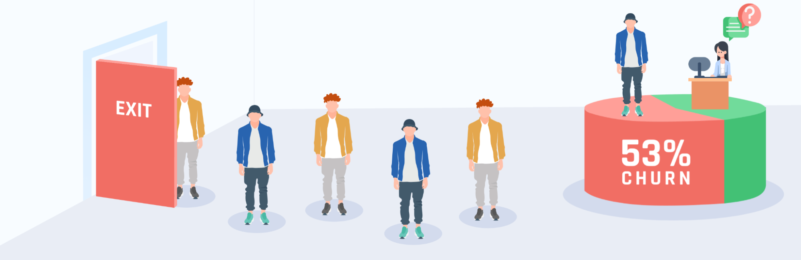
Telco Customer Churn and Segmentation

Slide 2
Introduction Telco
About this Project
This project uses customer data from a telecommunication company. This company provides internet, mobile and streaming services among other things.

Slide 3


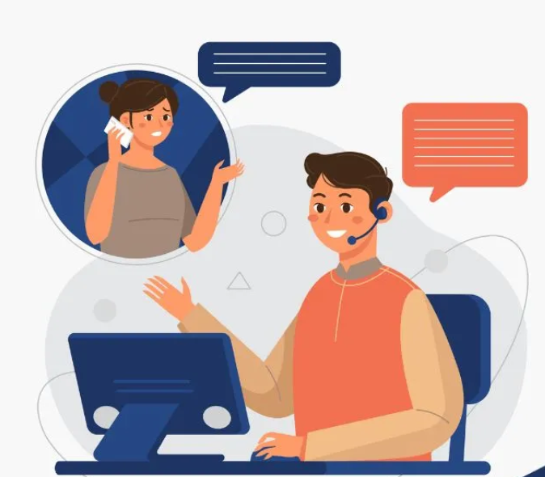
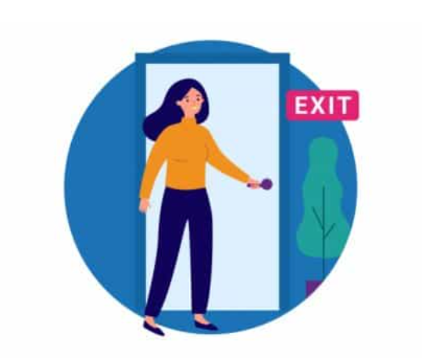
Objectives:
Predict whether or not a customer will continue using the company’s services.
Create segmentations based on churned customers.
Find ways to prevent future customer churn and increase customer retention based on previous findings.
Demographic
gender, age range, whether a customer has a partner or any dependents.
Account Information
About Dataset
tenure, contract type, payment method, paperless billing, monthly and total charges.
Service Type
services the customers have signed up for such as phone, internet, online security, streaming, etc.
Customer Churn
whether or not a customer chooses to stay with the company.

Slide 4
Timeline Project
13 Nov
14 Nov
15 Nov
Project Planning
Project Initiation
Project Development
Data Understanding
Data Cleaning
Data Pipeline
EDA
Machine Learning Creation
Data Visualization
Model Improvement
17 Nov
16 Nov
Project Presentation
Project Finishing
Model Deployment
Testing

Slide 5


Airflow
1
2
Database
Cleaning Data
Automatically fetch data from Database once every month using Apache Airflow
The new data automatically goes through a cleaning process to ensure the data is always good to use

Slide 6
01 Exploratory Data Analysis

Slide 7
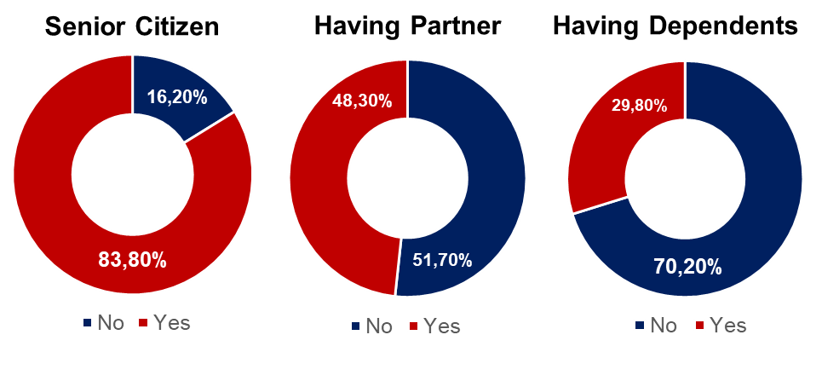
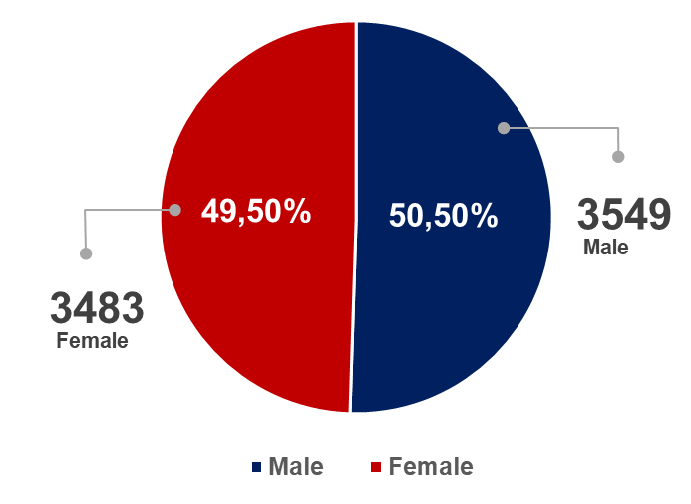
Customer Demographic
Gender
7032 Population
5163 no churn
1869 churn (Female 939, Male 930)
1142 Senior Citizen
5890 Not Senior Citizen
3393 Have Partner
3639 Not Have Partner
2099 Have Dependents
4933 Not Have Dependents

Slide 8
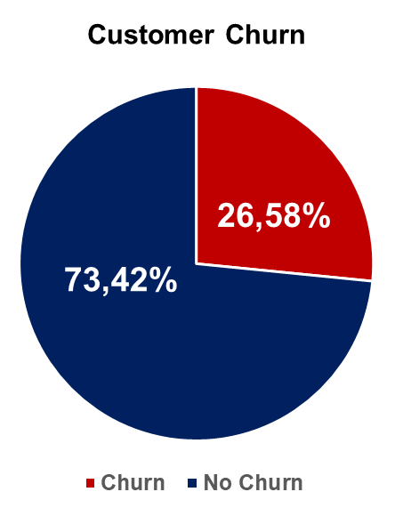
1869 Churn from 7032 customer
26,58%
Churn rate
$139.130,85
Churn, Potential loss

Slide 9
Churn By Tenure
Tenure Year | Meaning
1 | 0-12 Month
2 | 13-24 Month
3 | 25-36 Month
4 | 37-48 Month
5 | 49-60 Month
6 | 61-72 Month
Tenure year 1 have the most customer churn
The churn rate tends to decrease from tenure year 2 to 6
Customers with a longer tenure period tend to be more loyal.

Slide 10
Churn By Monthly Charge
Low Expense : $0 - $30
Medium Expense : $31 - $60
Medium High Expense : $61 – $90
High Expense : $91 - $120
The highest churn by monthly charges is at medium high expense.

Slide 11
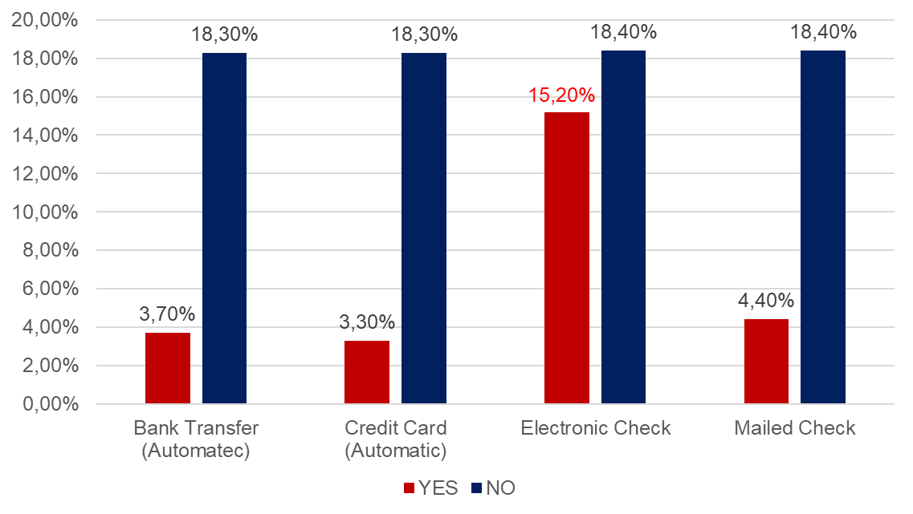
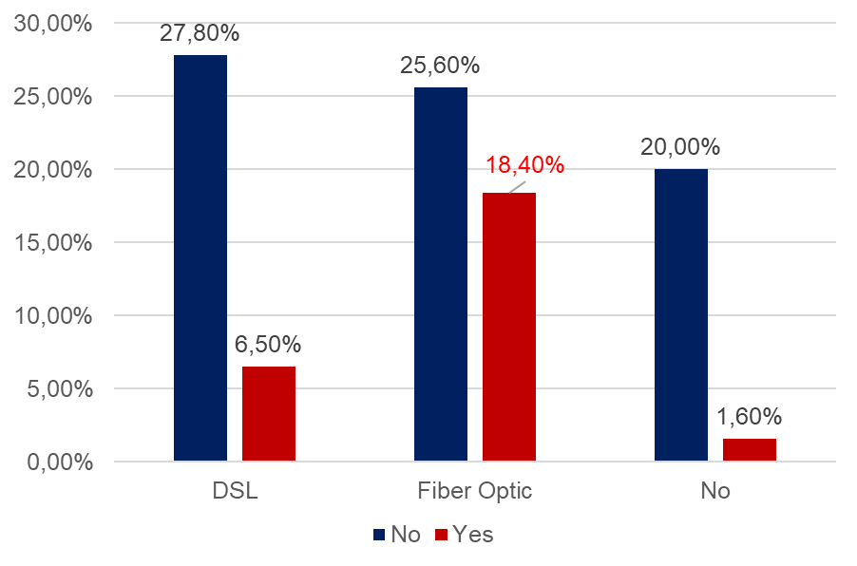
Churn By Payment Method
Churn By Internet Service
Electronic Check have the most customer churn rate in payment method
Investigate the problem and find the solution
Fiber Optic contribute the most customer churn rate
Need to evaluate Fiber Optic Services
Need Improvement on DSL to reduce churn

Slide 12
02
Model Development

Slide 13
Model
Logistic Regression Baseline precision
Deep Learning
Precision - Train
Precision - Train
72,6%
71,5%
Precision - Test
Precision - Test
68,3%
67,9%
Predict Time 0,1s
Predict Time 13s
AdaBost (Logistic Regression)
AdaBost (Logistic Regression) Improvement
Precision - Train
Precision - Train
71,5%
79,5%
Precision - Test
Precision - Test
67,9%
82,8%
Predict Time 2s
Predict Time 0,1s

Slide 14
03
Problem Finding

Slide 15
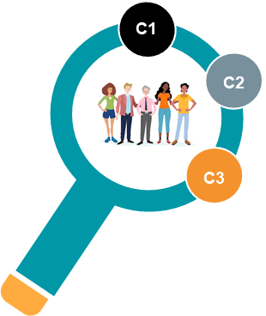



Clustering
Elder Group (Cluster 1)
Mixage (Cluster 2)
Young Blood (Cluster 3)
Characteristic:
Most are Senior Citizens
Have a partner and dependent
High expense monthly charges.
Characteristic:
Mix of senior and non senior citizens
Have a partner and dependent
low expense monthly charges
Characteristic:
Mostly is non-senior citizens.
Mostly have no partner and dependent
Medium expense monthly charges.
446 People
477 people
946 people

Slide 16
Cluster 1
Suggestion
Satisfaction Survey
01
Conduct customer satisfaction survey to identify the cause of their dissatisfaction
Offer Long-term Contract Package
02
Conduct a long-term contract package with various benefit
Elder Group (Cluster 1)
Limited Time Offer
Characteristic:
Most are Senior Citizens
Have a partner and dependent
High expense monthly charges.
03
Use limited time offer to create a sense of urgency. And feel like they might miss an opportunity
04
Maintain a Good Communication
446 People
Improve service quality by handling customer complain, inform our new package

Slide 17
Cluster 2
Suggestion
Maintain a Good Communication
01
Improve service quality by handling customer complain, inform our new package
Mixage (Cluster 2)
Offering Long-term Contract Package
02
Conduct a long-term contract package with various benefit because this cluster tend to have a short tenure
Characteristic:
Mix of senior and non senior citizens
Have a partner and dependent
low expense monthly charges
New Customer Onboarding and orientation
03
Improve onboarding and orientation for new customers so they understand terms and condition of the services / package.
477 people

Slide 18
Cluster 3
Suggestion
Satisfaction Survey
01
Conduct customer satisfaction survey to identify the cause of their dissatisfaction
Young Blood (Cluster 3)
Appropriate Internet Services
Characteristic:
Mostly is non-senior citizens.
Mostly have no partner and dependent
Medium expense monthly charges.
02
Make an affordable internet package prices for this cluster
Provides Variation in Payment Method
03
Consider variation in payment options since electronic check is the main causes of customer churn
946 people

Slide 19
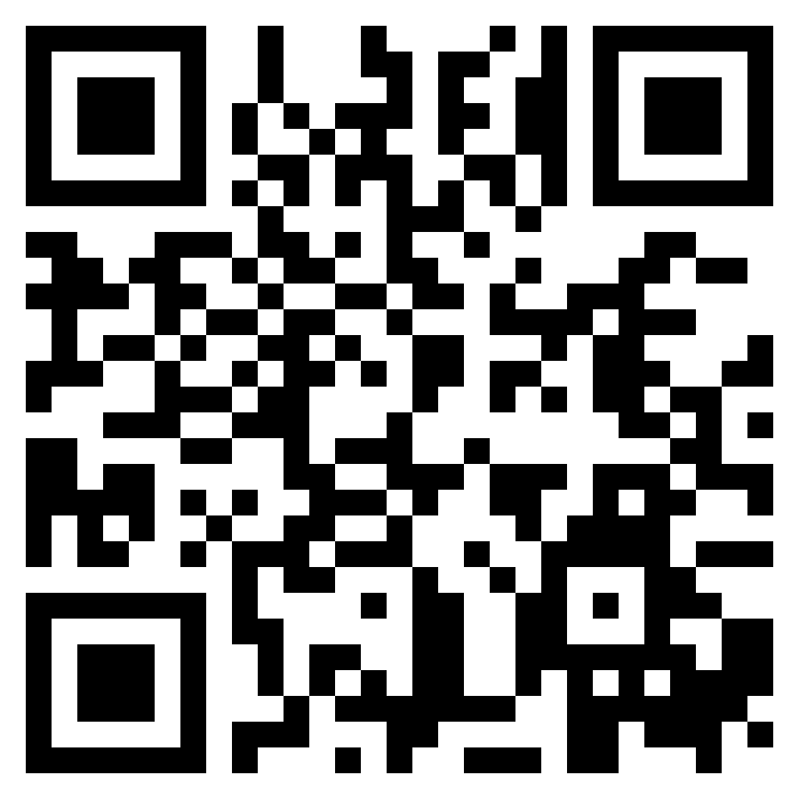


04
Machine Learning Deploy

Slide 20
05
Conclusion

Slide 21
Conclusion
Recommendation
Cluster 1 – 3 show similarities in average tenure (Tenure Year 1)
Tend to churn quickly
Fiber optic internet services , high monthly charges, and electronic payment check is the main issues that lead to customer churn.
Improving Service Quality
Always provide a great
services to retaining customers.
Loyalty Program and Package
Make a loyalty program to
loyal customers.
Monitoring and Evaluation
Continuous management function to
assess if progress is made in achieving
expected results.
Maintain a Good Relationship
Seek feedback, Celebrate your
customers.

Slide 22
Challenges
Data Limitation
Lacks detail on dataset, No age in dataset
Time Limitation
Model Predict
Short deadline
Difficult to find a good and suitable prediction model
Imbalance Dataset
Difficult to build a good model

Slide 23
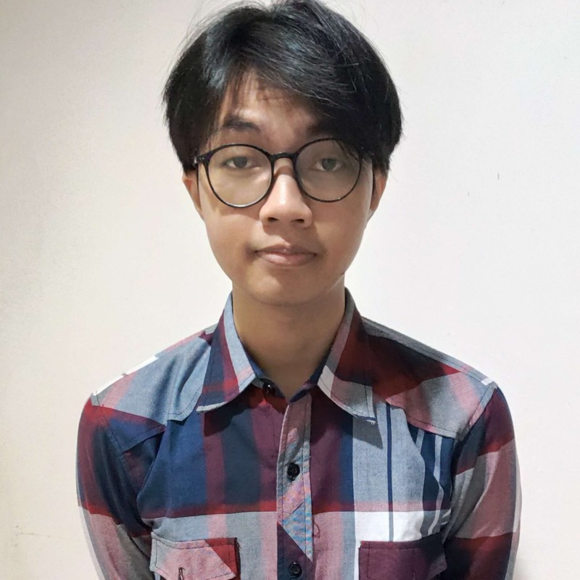

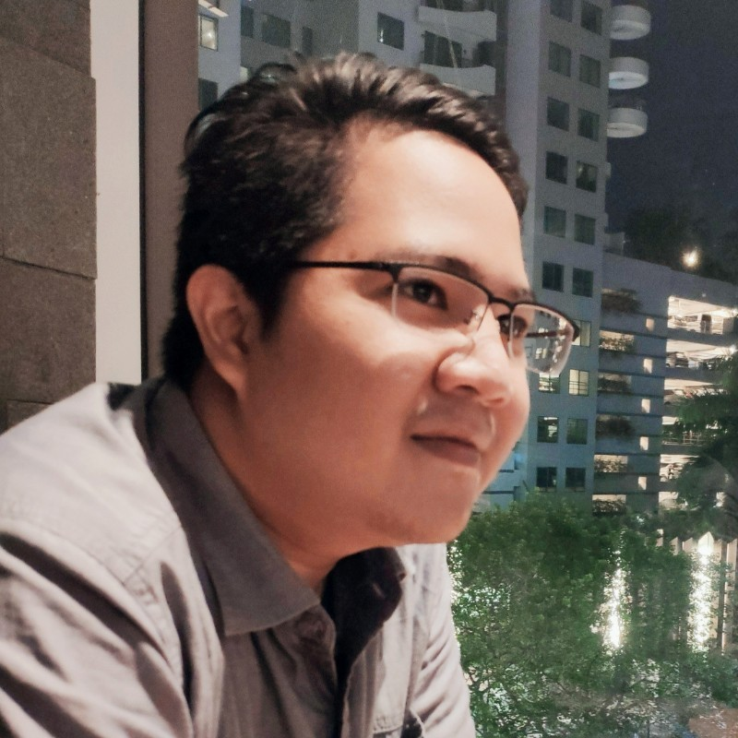
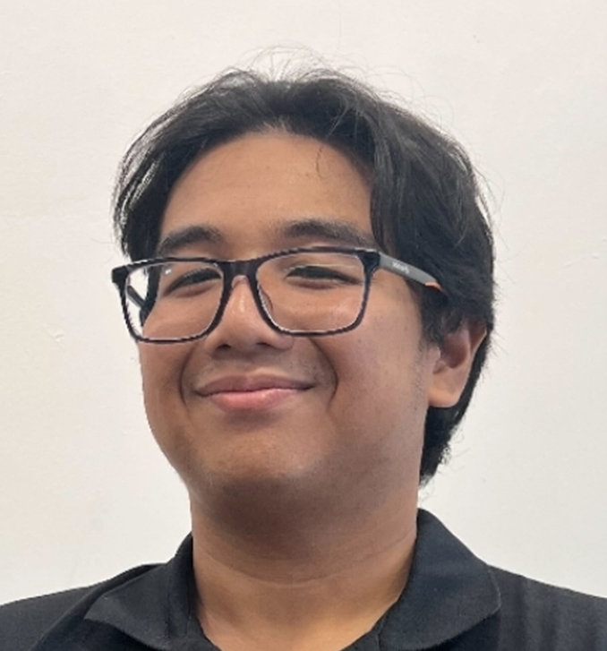
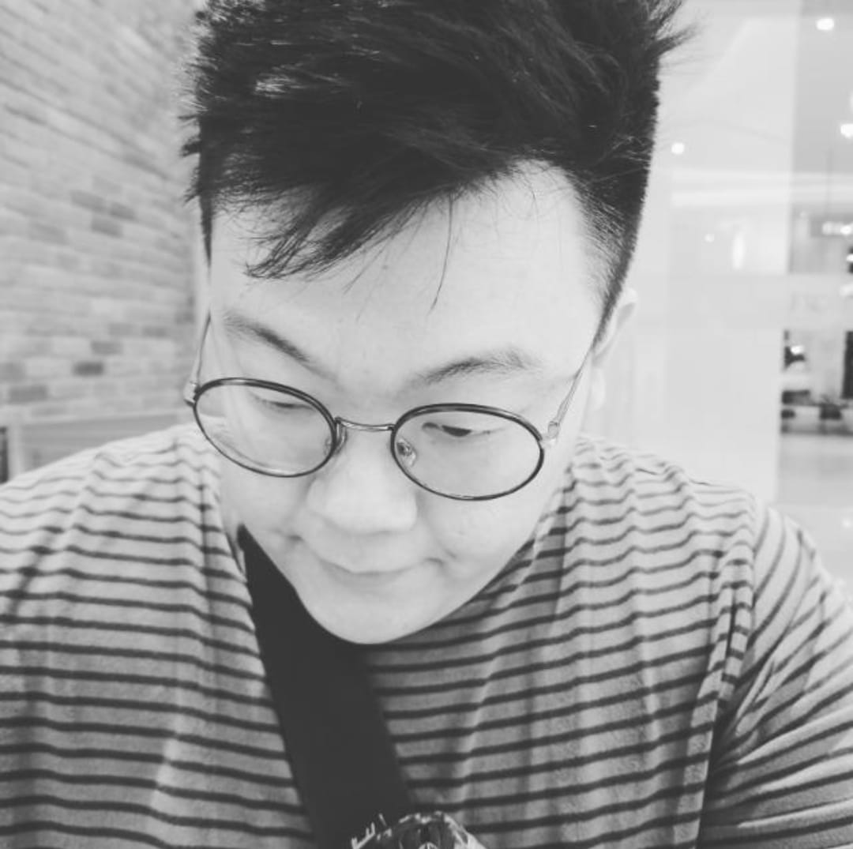
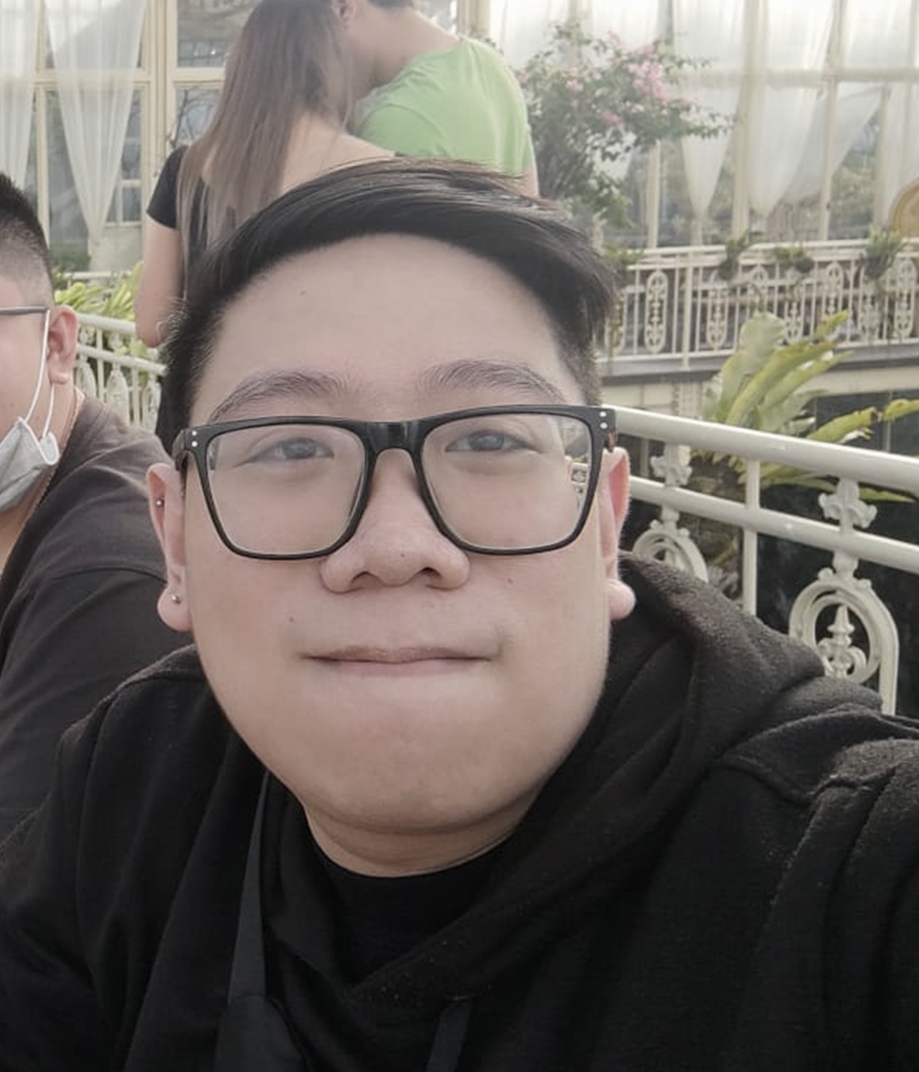





our
instructors
Thank You
Fredyco R.
OUR
TEAM
Gilang W.
FTDS-SBY-001
Data Engineer
0812 3267 8017
gilang.wirad@gmail.com
Joshua OK.
FTDS-SBY-001
Data Scientist
0851 0315 0098
jo.osaze@gmail.com
Stephanus AS.
FTDS-SBY-001
Data Analyst
0877 0315 1157
stephanus.adinata@gmail.com
Samuel CS.
FTDS-SBY-001
Data Analyst
0811 3551 168
samchrissun94@gmail.com
Hacktiv8id
Hacktiv8id
Hacktiv8
Hacktiv8 Indonesia

